Slide 1


Implementing schema resolvers
Notes:
This lesson covers
Using Node.js drivers for PostgreSQL and MongoDB
Using an interface to communicate with a GraphQL service
Making a GraphQL schema executable
Creating custom object types and handling errors
In the previous lesson, we designed the structure of the GraphQL API schema and came up with its full SDL text. In lessons 5-8, we are going to make that schema executable. We’ll use Node.js database drivers and the GraphQL.js implementation to expose the entities in the databases by using resolver functions.

Slide 2
Running the development environment
Setting up the GraphQL runtime
Communicating over HTTP
Building a schema using constructor objects
Generating SDL text from object-based schemas
Working with asynchronous functions
Table of Contents

Slide 3
Running the development environment
We will use this repository in lessons 5-10.
It has the skeleton for both the API server (which we’re going to build in lessons 5-8) and the skeleton for the web server (which we’ll build in lessons 9 and 10).
Clone that repo.
git clone https://az.dev/gia-repo graphql
Notes:
NODE.JS AND LINUX
You need a modern version of Node.js installed in your OS to follow along from this point. If you don’t have Node, or if you have an old version (anything less than 12), download the latest from nodejs.org and use that.
Some familiarity with the Node.js runtime is required. You don’t need to be an expert in Node, but if you have never worked with it before, it would help if you learn its basics before proceeding with this lesson. I wrote a short introductory course on Node, which you can get at az.dev/node-intro.
To let you focus on the GraphQL skills in this course’s project, I prepared a Git repository that contains all the non-GraphQL things that you need to follow up with the project.
All the commands in this course are for Linux. They will also work on a Mac machine because macOS is Linux-based. On Microsoft Windows, you’ll have to find the native equivalent of these commands, or you can spare yourself a lot of trouble and use the Windows Subsystem for Linux (see az.dev/wsl). If that is not an option, you can also run a Linux machine in a virtual hardware environment like VirtualBox.
If developing natively on Microsoft Windows is your only option, I recommend using PowerShell instead of the CMD command. Most Linux Bash shell commands work with PowerShell.
Microsoft Windows is not the best option when it comes to working with Node-based applications. Node was originally designed for Linux, and many of its internal optimizations depend on Linux native APIs. Windows support for Node started a few years after Node was first released, and there are active efforts to make it “better,” but it will never be as good as Node for Linux. Running Node on Windows natively is an option, but it will give you trouble. Only develop natively on Windows if you plan to host your production Node applications on Windows servers.

Slide 4

Running the development environment
Cloning the repo creates the graphql directory under your current working directory.
There, the first step is to install the initial packages that are used by the repo.
$ cd graphql
$ npm install

Slide 5
{
"name": "az.dev",
"version": "0.0.1",
"private": true,
"scripts": {
"scripts": {
"start-dbs": "docker-compose -f dev-dbs/docker.yml up",
"api-server": "(cd api && nodemon -r esm src/server.js)",
"web-server": "(cd web/src && rimraf .cache dist && parcel index.html)",
"start-blank-dbs": "docker-compose -f dev-dbs/docker-blank.yml up"
},
},
·-·-·
}
Running the development environment
Notes:
Take a look at the package.json file to see the initial packages I added. These packages are used by the API server (and by the web server later). Note that I provided the scripts we will need to run these two servers.
TIP
You can add as many npm run scripts as you need, and you should use them for any tasks you wish to introduce to the project. With npm run scripts, all developers on the team can run these tasks in a standard, consistent way.
Explore the repo, and notice its three directories:
The api directory is the focus of lessons 5-8. It’s where we will put the logic of the API server implementation. It has a bare-bone Express.js server configured with an example endpoint. I’ve also provided all the database configurations and SQL statements used throughout the course. Take a look around.
The web directory is the focus of lessons 9-10. It’s where we will put the logic of using the API server in a web application. It has a bare-bone React app configured with some mock data.
The dev-dbs directory has everything related to running dev database servers for development. You can use the files there to create your own database services and load them with sample data or to run the provided ready Docker images. We’ll do that in the next lesson.
TIP
Given the fast-changing ecosystem of GraphQL and other libraries used in the course, configurations and code samples may not work for you as is. Check out az.dev/gia-updates to see any updates that you may need to work through the course’s code examples.

Slide 6

Node.js packages
To implement the GraphQL API server, we need two new packages.
$ npm install graphql express
Notes:
For the GraphQL runtime service to communicate with databases like PostgreSQL and MongoDB, it needs a driver. We’ll use Node’s pg and mongodb packages for that purpose. These are not the only packages that can be used as drivers, but they are the most popular in Node’s ecosystem. These packages expose JavaScript APIs to execute operations for PostgreSQL and MongoDB. We’ll need to configure them to connect to these database services.
For a web server to host the project’s API endpoint, we will use Express.js. There are a few other Express-related packages that we need. All these packages are already installed in the repo’s starting point.
The graphql package is for GraphQL.js, the JavaScript implementation of GraphQL. It takes care of things like validating and executing GraphQL operations.
To work with a GraphQL runtime, we need an interface. This is where the express-graphql package comes in handy. It has an HTTP(S) listener function that is designed to be used with a middleware-based web framework like Express and acts as an interface to a GraphQL schema.
TIP
Although it’s named express-graphql, this package can work with any HTTP web framework that supports connect-style middleware (Hapi, Fastify, and many others).
Environment variables
Under the api directory is a .env file that contains the default environment variables we need in this project. If you do not plan to use any of the project’s defaults, you’ll need to change these variables. This file is automatically loaded, and its variables are exported in api/src/config.js.
TIP
Environment files like .env usually are not part of the source code as they will need to be different on different machines and environments. I’ve included a .env file in the repo to keep things simple.

Slide 7
Running the development environment
Setting up the GraphQL runtime
Communicating over HTTP
Building a schema using constructor objects
Generating SDL text from object-based schemas
Working with asynchronous functions
Table of Contents

Slide 8
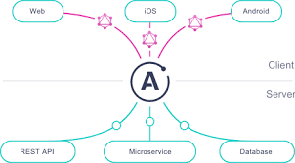
Setting up the GraphQL runtime
Suppose we are creating a web application that needs to know the exact current time the server is using (and not rely on the client’s time).
We would like to be able to send a query request to the API server as follows.
{
currentTime
}
Notes:
We can now start the implementation of the project's GraphQL runtime layer. Let's first work through a very simple example so that we can focus on testing the runtime layer setup and understanding its core dynamics.

Slide 9
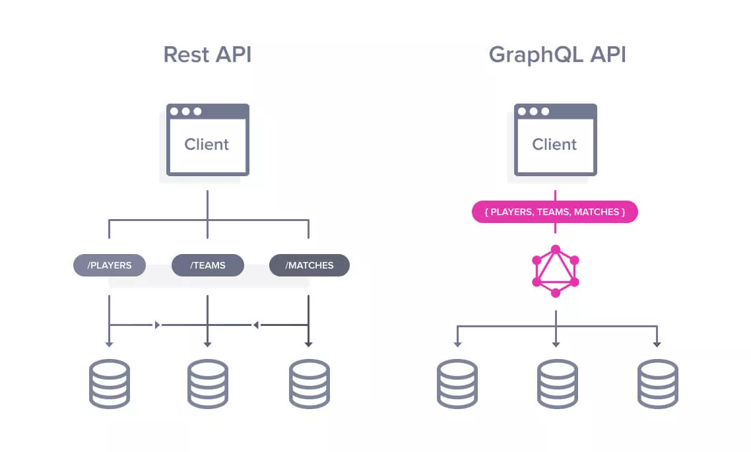
Setting up the GraphQL runtime
To respond to this query, let’s make the server use an ISO UTC time string in the HH:MM:SS format.
{
currentTime: "20:32:55"
}
Notes:
This is a simple GraphQL request with a single operation (a query operation). GraphQL requests can also have multiple operations and include other information related to these operations (for example, variables).
For the server to accomplish this current time communication, it needs to
Have an interface for a requester to supply a GraphQL request.
Parse the supplied request and make sure it has valid syntax according to the GraphQL language rules.
Validate the request using a schema. You cannot run just any request on a GraphQL server: you can only run the ones allowed by its schema. The server also needs to validate that all the required parts of the request are supplied. For example, if a query uses variables, then the server needs to validate their existence and make sure they have the right types. If a request has more than one operation the server needs to validate that the request also includes the name of the operation that should be executed for the response.
Resolve all fields in the request into scalar data elements. If the request is for a mutation operation, the server must perform the side effects of that mutation. If the request is for a subscription operation, the server must open a channel to communicate data changes when they happen.
Gather all the data for the response, and serialize it into a format like JSON. The serialized response needs to include the request structure and its resolved data (and any errors the server encountered).
Have an interface for the requester to receive the response text generated for their request text.
All of these tasks are shared among all GraphQL requests the server has to deal with. In fact, except for the tasks where I used the italicized words (schema and resolve), all other tasks are shared among all GraphQL services. This means they can be abstracted and reused. We don’t have to do them for each service.
Luckily, this has been done already! We don’t have to reimplement any of the previous steps except dealing with schemas and resolvers. The rest is where a GraphQL implementation (like GraphQL.js) comes into the picture.
What exactly is a GraphQL implementation? It’s basically code written in a certain language to do the bulk of the work described in the previous six steps. It exposes its own code APIs, which your code can use to perform the generic behaviors expected of a GraphQL server. Another example of a GraphQL implementation in JavaScript is Apollo Server, which wraps GraphQL.js and enhances it with many features like SDL-first implementation and a subscription-ready transport channel. We’ll see an example of using Apollo Server in lesson 10.
As a GraphQL service developer, you can use your GraphQL implementation of choice to do most of the heavy lifting like parsing, validating, and executing GraphQL requests. This enables you to focus on your application logic details. You need to write a schema and come up with how the parts in that schema should be resolved (as data and side effects). We designed the AZdev schema in the previous lesson, and we will start implementing its resolvers in this lesson. However, before we do that, let’s work through the simple currentTime field example.

Slide 10
Creating the schema object
Create a schema directory under api/src, and put the following index.js file in it.
import { buildSchema } from 'graphql';
Notes:
For the very first GraphQL.js example, we need to use two of the functions exported by the graphql package:
The buildSchema function that builds a schema from a schema language text.
The graphql function to execute a GraphQL query against that generated schema. To avoid confusion, I’ll refer to it as the graphql executor function.
Let’s create two files: one to host the schema and resolver definitions and the other to execute the schema using query text supplied by the user. To keep this example simple, I’ll use a command-line interface to read the query text from the user instead of introducing a more featured user interface (like an HTTP server).
The buildSchema function takes a string written in the GraphQL schema language, which represents a set of types. Every object in a GraphQL schema must have an explicit type. This starts with the root of what the schema is offering. For example, to make the schema accept queries in general, you need to define the special Query type. To make the schema accept a currentTime field in a query operation, you need to add it within the Query type and mark it as a String.

Slide 11

Creating the schema object
Schema text for the simple example schema we’re building.
export const schema = buildSchema(`
type Query {
currentTime: String!
}
`);
Notes:
The string in listing 5.8 is the schema language text. Note the use of backticks to allow for having the text on multiple lines.
The result of executing buildSchema is a JavaScript object designed to work with the graphql executor function.

Slide 12
Creating resolver functions
Let’s create an object to hold the many resolver functions we will eventually have.
Here’s one way to implement the currentTime resolver logic.
export const rootValue = {
currentTime: () => {
const isoString = new Date().toISOString();
return isoString.slice(11, 19);
},
};
Notes:
We have a schema, and we can validate any request against it if we need to, but we have not told the GraphQL service what data to associate with the currentTime field in that schema. If a client asks for that field, what should the server response be?
This is the job of a resolver function. Each field defined in the schema needs to be associated with a resolver function. When it is time for the server to reply with data for that field, it will just execute that field’s resolver function and use the function’s return value as the data response for the field.
rootValue object will have more functions as we add more features to the API. It’s named rootValue because GraphQL.js uses it as the root of the graph. Functions within the rootValue object are the resolvers for the top-level nodes in your graph.
You can do anything you wish within a resolver function! For example, you can query a database for data (which is what we need to do for the AZdev API).
NOTE
I exported the schema and rootValue objects. Other modules in the server will need to import and use these objects.

Slide 13
Executing requests
We can test that in api/src/server.js. Add the following import line.
import { graphql } from 'graphql’;
Here’s an example of how you call it.
graphql(schema, request, rootValue);
Notes:
The schema and rootValue objects are the core elements in any GraphQL service. You can pass them to the graphql executor function along with the text of a query or mutation, and the executor will be able to parse, validate, execute, and return data based on them. This is what we need to do next to test the currentTime field.
The graphql executor function can be used for this purpose.
NOTE
The api/src/server.js file has some commented-out code to start a bare-bone express web server. You can ignore these comments for now.
This graphql executor function accepts a list of arguments: the first is a schema object, the second is a source request (the operation text), and the third is a rootValue object of resolvers.
TIP
The graphql executor function has more positional arguments that can be used for advanced cases. However, we will soon use an HTTP(S) wrapper to run this function instead of calling it directly, and we will use named arguments when we do.
The graphql executor function returns a promise.

Slide 14
Executing requests
In JavaScript, we can access the resolved value of this promise by putting the keyword await in front of it and wrapping the code with a function labeled with the async keyword.
async () => {
const resp = await graphql(schema, request, rootValue);
};
Notes:
NOTE
You don’t need to add listings with captions prefixed with “Example:” anywhere.
The promise resolves to the GraphQL response in JSON. Each GraphQL response has a data attribute that holds any successfully resolved data elements (and an error attribute if errors are encountered). Let’s just print the resp.data attribute.
For the three arguments of the graphql executor function, we can import the schema and rootValue objects from the previous file we worked on, but where do we get the request text?

Slide 15
Executing requests
The request text is something the clients of this API server will supply.
They’ll do that eventually over an HTTP(S) channel, but for now, we can read it directly from the command line as an argument.
We’ll test the server.js file this way.
$ node -r esm api/src/server.js "{ currentTime }"
Notes:
For this test, the request text is the third argument in the command line (for the npm run script). You can capture that in any Node script with process.argv[2].
THE PROCESS.ARGV ARRAY
In Node, process.argv is a simple array with an item for each positional token in the command line (that ran the process), starting with the command itself. For the command in listing 5.13, process.argv is
["path/to/node/command", "api/src/server.js", "{ currentTime }"]

Slide 16
Executing requests
import { graphql } from 'graphql';
import { schema, rootValue } from './schema';
const executeGraphQLRequest = async request => {
const resp = await graphql(schema, request, rootValue);
console.log(resp.data);
};
executeGraphQLRequest(process.argv[2]);
// ·-·-·
Notes:
Full code snippet in api/src/server.js that we can use to carry out this test.
We simply import the schema and rootValue that we prepared, wrap the graphql executor function in an async function, and use process.argv[2] to read the GraphQL request text from the user.
This example is complete! You can test it with the command in listing 5.13, and you should see the server report the time in UTC:
$ node -r esm api/src/server.js "{ currentTime }"
[Object: null prototype] { currentTime: '18:35:10’ }
TIP
The GraphQL.js implementation uses null-prototyped objects for data responses. This is why [Object: null prototype] is part of the response. The console.log function in Node reports that when it sees it. Null-prototyped objects are generally better for maps/lists because they start empty and do not inherit any default properties. For example, you can do ({}).toString(), but you cannot do Object.create(null).toString().
CURRENT CODE
You can use the command git checkout to synchronize your local repo with the current progress in the code (after the currentTime test).
The 5.1 part of this command is the name of a Git branch. The branch you start with when you clone the repo is named main. You can always go back to any branch using the checkout command. You can also make your own commits on a branch until we check out the next branch. This will enable you to use the git diff command to compare your work with mine if you want to.
If you’ve made any local changes so far, you need to either commit them or get rid of them before you check out a new branch. You can also stash them with the command git add . && git stash.

Slide 17
Running the development environment
Setting up the GraphQL runtime
Communicating over HTTP
Building a schema using constructor objects
Generating SDL text from object-based schemas
Working with asynchronous functions
Table of Contents

Slide 18
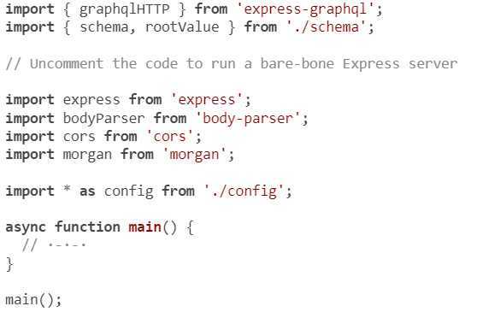
Communicating over HTTP
Notes:
Before adding more fields to this API, let’s use a better interface than the simple command line. Let’s communicate with the GraphQL service via HTTP. To do that, we need an HTTP server.
TIP
You should host your GraphQL services behind an HTTPS service. You can use Node to create an HTTPS server, but a better option is to use a web server like NGINX (or a web service like Cloudflare) to protect your HTTP service and make it available only over HTTPS.
We’re going to use the express package to create an HTTP server and the express-graphql package to wire that server to work with the GraphQL service that we have so far.
TIP
For reference, the code to run a bare-bone Express server is commented out in api/src/server.js.
Remove the executeGraphQLRequest function and the graphql executor function (in api/src/server.js). Instead, import the graphqlHTTP named export from the express-graphql package.
The default export in the express package is a function. To create an Express server, you just invoke that function. Then you can use the listen method on the created server to make the server listen to incoming connections on a certain port. That part is already done in the main function.
When you run this code, an HTTP server will listen on port 4321. To make the server accept incoming connections for a certain HTTP URL/VERB combination (like GET /), we need to add a server.get method (or .post, .put, or .delete) or the generic server.use method that makes the server accept all HTTP VERBs for a certain URL.

Slide 19
Communicating over HTTP
The provided main function has an example of a server.get call.
Here is the signature of the server.VERB methods and an example of what you can do within it.
server.use('/', (req, res, next) => {
// Read something from req
// Write something to res
// Either end things here or call the next function
});
Notes:
The first argument for the .use method is the URL for which the server will start accepting connections. The second argument is the function that will be invoked every time the server accepts a connection on that URL. This function is usually called the listener function.
The listener function exposes two important objects as arguments, req and res (the next object is not usually used for response handlers):
The req object is how the service can read information from the HTTP request. For example, we need to read the text of the query/mutation (and other related objects) from a client that is using this API. We can do that using req.
The res object is how the service can reply with data to the client that is requesting it. This is how the API server responds with the data it generates for incoming GraphQL requests.
Between reading from the request and writing to the response, we will need to execute the graphql executor function just as we did for the command-line test. This will happen for each GraphQL request, and it’s another general process that can be abstracted and reused.
The graphqlHTTP function we imported from express-graphql is a listener function that does exactly that. It will parse the HTTP request, run the graphql executor function, await its response, and send its resolved data back to the requester. We just need to tell it what schema and rootValue objects to use.

Slide 20
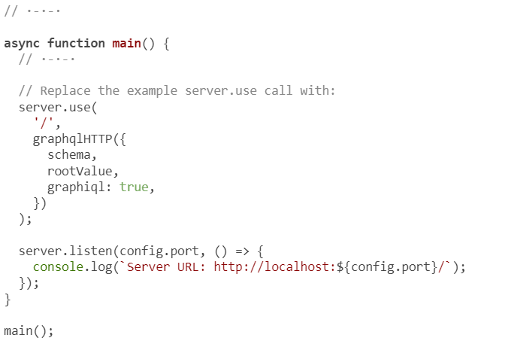
Communicating over HTTP
Notes:
Here’s the .use method wired to work with the graphqlHTTP function. Put this in api/src/server.js, replacing the provided example server.use('/') call.
This will allow us to communicate with the schema over HTTP. Not only that, but by using graphiql: true in the configuration object, we will also get the mighty GraphiQL editor mounted on that URL, and it will work with our schema!
TIP
The graphqlHTTP function call returns a handler function that expects req/res arguments. That matches the signature needed for the use method’s handler function (its second argument).

Slide 21

Communicating over HTTP
Let’s test. Start the API server with the following command.
$ npm run api-server
You should see this message:
Server URL: http://localhost:4321/
Notes:
Then head over to http://localhost:4321/. You should see the GraphiQL editor

Slide 22
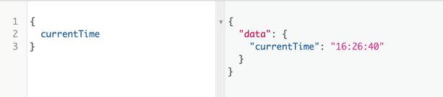
Communicating over HTTP
You should be able to test the currentTime field query in it, as shown in figure
Notes:
NOTE
The API server is configured to run with the nodemon command instead of the node command. nodemon runs a node process while monitoring files for changes and automatically restarts that node process when it detects changes to the files. That makes the API server auto-restart whenever you save any file in the api directory.
Note that the entire HTTP channel to communicate with the server has nothing to do with the GraphQL service. It’s just another service layer offering a convenient way to communicate with the GraphQL service layer. A web application can now use Ajax requests to retrieve data from the GraphQL service. In a large-scale GraphQL API service, this HTTP communication layer would be a separate entity that can be managed and scaled independently.
TIP
You can turn off the GraphiQL editor in production (if you want to) and use .post instead of .use for the graphqlHTTP handler. That way, the service will only work for Ajax post requests.

Slide 23
Running the development environment
Setting up the GraphQL runtime
Communicating over HTTP
Building a schema using constructor objects
Generating SDL text from object-based schemas
Working with asynchronous functions
Table of Contents

Slide 24
Building a schema using constructor objects
GraphQL.js has another format that can be used to create a GraphQL schema and its various types.
Instead of text written with the schema language, you can use JavaScript objects instantiated from calls to various constructor classes.
Notes:
The GraphQL schema language is a great programming-language-agnostic way to describe a GraphQL schema. It’s a human-readable format that’s easy to work with, and it is the popular, preferable format for describing your GraphQL schemas. However, it has some limitations.
For example, you can use the GraphQLSchema constructor to create a schema object, the GraphQLObjectType constructor to create an object type, the GraphQLUnionType to create a union type, and many more classes just like these.
This format is useful if you need to construct a schema programmatically. It’s more flexible and easier to test, manage, and extend.
NOTE
The method of using objects to create a GraphQL schema does not have a universally agreed-on name. I’ve heard “code-first” and “resolvers-first,” but I don’t think these names fairly represent the method. I’ll refer to it in this course as the object-based method.
Let’s start exploring this object-based method by converting the schema we have so far (which only supports a currentTime field).

Slide 25
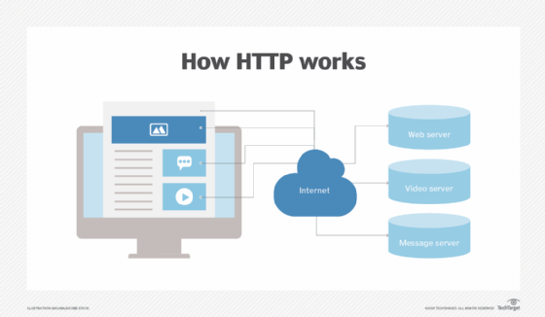
The Query type
To create a GraphQL schema using this method, we need to import a few objects from the graphql package, as follows.
import {
GraphQLSchema,
GraphQLObjectType,
GraphQLString,
GraphQLInt,
GraphQLNonNull,
} from 'graphql';
Notes:
Since we are now going to use the object-based method to build the schema, you can delete everything you have so far in api/src/schema/index.js.

Slide 26
The Query type
Type-based objects are designed to work together to help us create a schema.
For example, to instantiate a schema object, you just do something like this.
const schema = new GraphQLSchema({
query: new GraphQLObjectType({
name: 'Query',
fields: {
// Root query fields are defined here
}
}),
});
Notes:
These calls to GraphQLSchema and GraphQLObjectType return special objects designed to work with the graphql executor function.

Slide 27
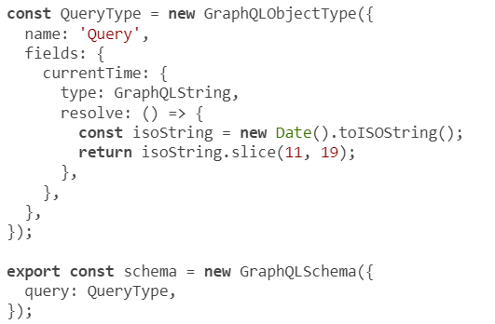
The Query type
Notes:
Instead of inlining the call to GraphQLObjectType, let’s extract it into its own variable. I’ll name it QueryType. In this type’s fields property, we need to add the currentTime field, specify its type, and include its resolver function. Here’s the code.
TIP
Don’t memorize the ways to use these constructor and type helpers. Just understand and retain their capabilities and what they enable you to do.
An object type has a name and a list of fields (represented with an object). Each field has a type property and a resolve function.
This code maps to the schema-language version we had before. We’re just doing it with objects instead of strings. Instead of currentTime: String, this method requires defining a property currentTime and giving it a configuration object with a type of GraphQLString. Instead of a rootValue object, we define a resolve function.
The resolve function is the same one we had under the rootValue object, but now it’s part of the schema object. Using the object-based method, we don’t need a rootValue object because all resolvers are included where they’re needed alongside their fields. The schema object created with GraphQLSchema is executable on its own.
I used the GraphQLString scalar type for currentTime. The GraphQL.js implementation offers a few similar scalar types, including GraphQLInt, GraphQLBoolean, and GraphQLFloat.

Slide 28
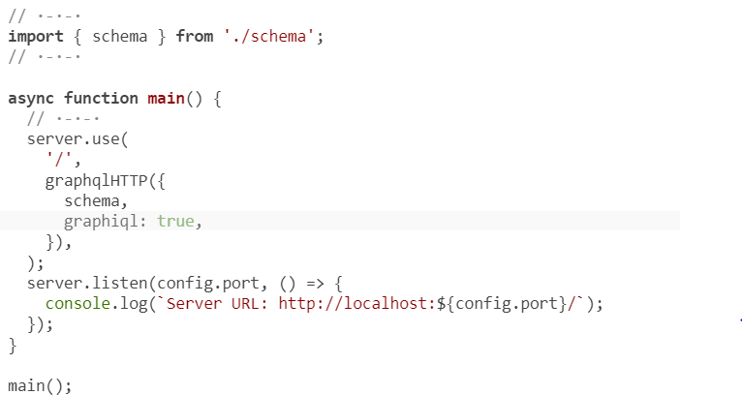
The Query type
Notes:
To test this code, we need to remove the rootValue concept from api/src/server.js.
That’s it. You can test in GraphiQL that the service supports the currentTime field, but now using the object-based method.
CURRENT CODE
Use git checkout to reset your local repo to the current progress in the code.

Slide 29
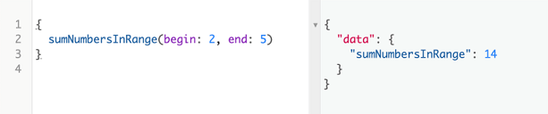
API support a sumNumbersInRange field that accepts two arguments
Notes:
To explore the GraphQL.js API further, let’s look at an example with a bigger scope. Let’s make the API support a sumNumbersInRange field that accepts two arguments (begin and end) representing a range of numbers and returns the sum of all whole numbers in that range (inclusive to its edges). Figure shows the desired end result.

Slide 30
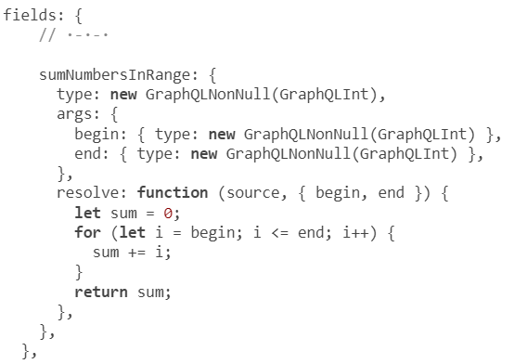
Field arguments
Notes:
Here’s a simple implementation of the sumNumbersInRange field. Add this to the fields property for QueryType.
The sumNumbersInRange field has a type of new GraphQLNonNull(GraphQLInt). The GraphQLNonNull wrapper around this integer type indicates that this field will always have a value. The response of a sumNumbersInRange field in a query will never be null.
The definition of sumNumbersInRange included an args property to define the structure of the arguments it accepts and their types (which I defined using new GraphQLNonNull(GraphQLInt) as well). Both of these arguments are required. A client cannot ask for the sumNumbersInRange field without specifying the begin and end numbers for that range. The GraphQL service will throw an error if that happens.
The resolver function for sumNumbersInRange makes use of its arguments. The first argument is always the source parent object of that resolved level. For sumNumbersInRange, there is no parent object because it is a root field. The second argument for the resolve function exposes the field argument values as defined by the API consumer. I destructured begin and end from that argument as both of these values are required.

Slide 31
Field arguments
The resolver function simply loops over the range, computes the sum, and returns it.
Use the following query to test the new field this API now supports.
{
sumNumbersInRange(begin: 2, end: 5)
}
Notes:
Note that the sumNumbersInRange field has no sub-selection set because it’s a leaf field that resolves to a scalar value. However, to learn about custom object types, next we will change it to a non-leaf field that requires a sub-selection set.
NOTE
The GraphQLNonNull helper is the GraphQL.js way to specify a type modifier, and it’s equivalent to the exclamation mark in the schema language. The equivalent of adding square brackets to make a list is the GraphQLList type modifier. For example, to define a field that represents an array of strings, the type would be new GraphQLList(GraphQLString).

Slide 32
Custom object types
How the new numbersInRange field will be queried.
{
numbersInRange(begin: 2, end: 5) {
sum
count
}
}
Notes:
So far, we’ve created one object type to represent the root fields under the query type. To explore using custom object types, let’s replace the sumNumbersInRange leaf field with a numbersInRange object field that supports the same begin and end arguments, and let’s make it support two leaf fields for the sum and count of the whole numbers in the range.
To implement this, we need to define a custom object type to represent the new “numbers in range” structure, which looks like an object that has sum and count properties. Let’s name it NumbersInRange.
To organize the code for GraphQL object types, let’s create a file for each, starting with this new type for the numbersInRange field.

Slide 33
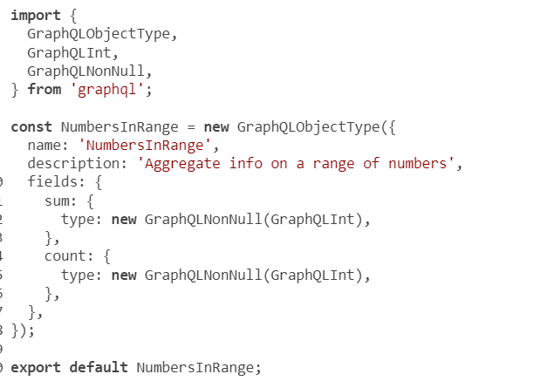
Custom object types
Notes:
Create a new directory api/src/schema/types, and create a numbers-in-range.js file there to implement the NumbersInRange type.
Besides the name property, we can give each type an optional description property to describe the type. Both of these will show up in GraphiQL’s Docs explorer when the new NumbersInRange type is used in the main schema.
TIP
You can use rich-text formats like Markdown in these description properties and then have the client tool render them in a more readable way. GraphiQL supports rendering Markdown in descriptions out of the box!
Note that the sum and count fields in the NumbersInRange type do not have resolver functions. Although this design makes sum and count leaf fields, having resolver functions for them is optional. This is because these leaf fields can use the default trivial resolvers based on properties defined on their parent source object. For this to work, the object resolved as the parent object (which is of type NumbersInRange) has to respond to sum and count methods.

Slide 34
Custom object types
// ·-·-·
export const numbersInRangeObject = (begin, end) => {
let sum = 0;
let count = 0;
for (let i = begin; i <= end; i++) {
sum += i;
count++;
}
return { sum, count };
};
Notes:
Let’s create a function that takes begin and end as arguments, computes the sum/count, and returns an object with sum and count properties. Here’s one way to implement that (you can put this code in the api/src/utils.js file).
TIP
There is a better way to compute the count and sum of consecutive numbers in a range without using a loop: you can use the arithmetic progression formulas. I used a loop for simplicity.

Slide 35
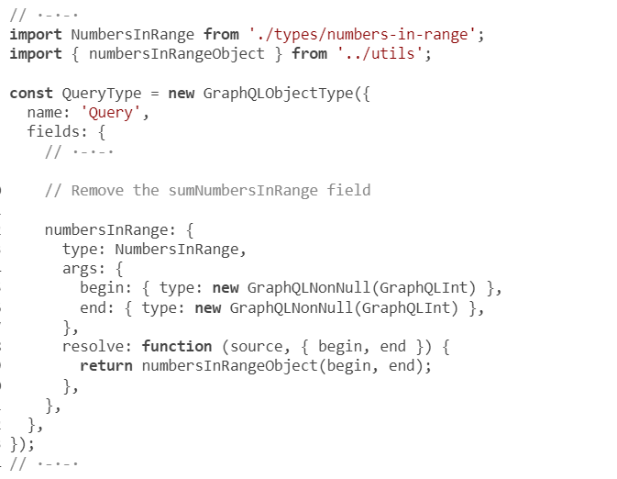
Custom object types
Notes:
Now we need to change the QueryType object. It has a non-leaf field named numbersInRange, and that field needs to be resolved with the object returned by calling the numbersInRangeObject helper function.

Slide 36
Custom object types
If you test the API now, you should be able to execute a query like the following:
{
numbersInRange(begin: 2, end: 5) {
sum
count
}
}
And you will get this response:
{
"data": {
"numbersInRange": {
"sum": 14,
"count": 4
}
}
}
Notes:
CHALLENGE
Add an avg field to the NumbersInRange type, and make it return the sum divided by the count.

Slide 37
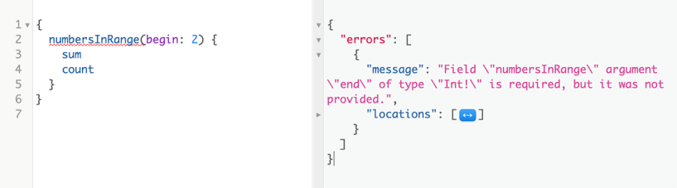
Custom errors
Notes:
A GraphQL executor automatically handles any invalid queries or types used for arguments in the query. For example, if you omit one of the required arguments, you get the error shown in figure

Slide 38
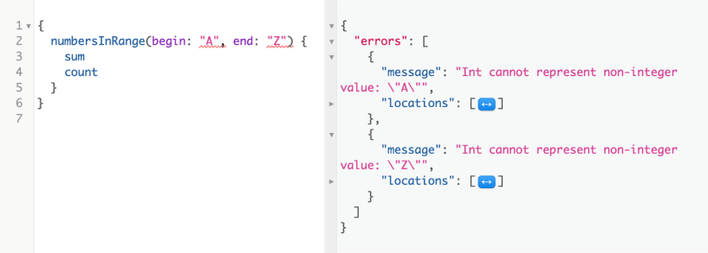
Custom errors
Notes:
If you use strings instead of integers for begin and end, you get the error shown in figure

Slide 39
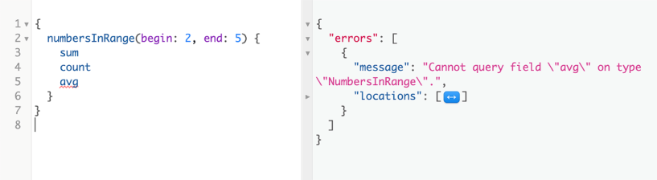
Custom errors
Notes:
And if you attempt to query for a nonexisting leaf field, you get the error shown in figure
This is the power of a strongly typed schema. You get many great validations out of the box, but what about the custom cases? What should happen if a requester specifies an invalid range for the numbersInRange field (for example, using an end value that is less than the begin value)?

Slide 40
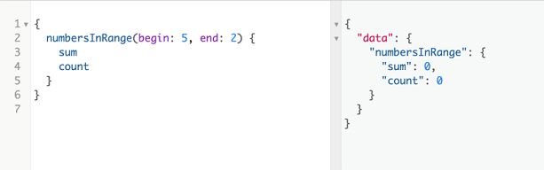
Custom errors
The API currently ignores this case and just returns zeros, as shown in figure
Notes:
Let’s fix this. Let’s change the API to reject this input and, instead of returning zeros, return a custom error message to the requester. If the range is invalid, the requester should be made aware of that fact, because otherwise, bugs might sneak into the code.

Slide 41
Custom errors
We do the check in the resolver function for the numbersInRange field and throw an error with our custom message.
export const numbersInRangeObject = (begin, end) => {
if (end < begin) {
throw Error(`Invalid range because ${end} < ${begin}`);
}
// ·-·-·
};

Slide 42
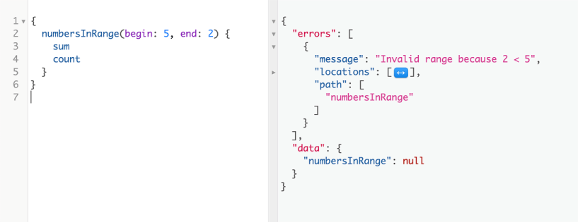
Custom errors
Notes:
Now, if you attempt to make an invalid range query, you get the message shown

Slide 43
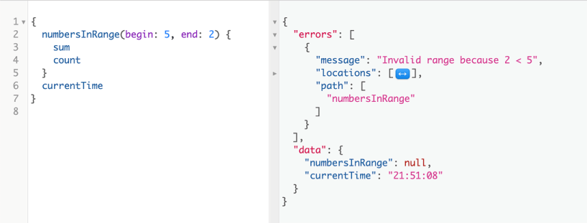
Custom errors
Notes:
Note that the errors are again delivered as part of the JSON response (and not through HTTP error codes, for example). In some cases, the JSON response may have both errors and partial data that is not affected by the errors. You can test that by including the currentTime field in a query with a bad range for numbersInRange; see figure
Did you notice how I made the numbersInRange field nullable in listing 5.28? For this particular case, a numbersInRange field may be absent from the response when the range it uses is invalid. This is another example of a case where nullability is okay because I am attaching a semantic meaning to it. Also, because numbersInRange is a root field, making it non-nullable will prevent having a partial response in other root fields (like currentTime) when there is an error in the range.

Slide 44
Running the development environment
Setting up the GraphQL runtime
Communicating over HTTP
Building a schema using constructor objects
Generating SDL text from object-based schemas
Working with asynchronous functions
Table of Contents

Slide 45
Generating SDL text from object-based schemas
import {
// ·-·-·
printSchema,
} from 'graphql';
// ·-·-·
export const schema = new GraphQLSchema({
query: QueryType,
});
console.log(printSchema(schema));
Notes:
The executable schema object that we created using the object-based method can be converted to the schema-language format using the printSchema function, which is another function we can import from the graphql package. We call it and pass in the executable schema object (the one exported by api/src/schema/index.js) as the argument.

Slide 46
Generating SDL text from object-based schemas
Here’s what you’ll see.
type Query {
currentTime: String
numbersInRange(begin: Int!, end: Int!): NumbersInRange
}
"""Aggregate info on a range of numbers"""
type NumbersInRange {
sum: Int!
count: Int!
}
Notes:
This is the schema representation without the resolver functions, but it is a lot more concise and readable.

Slide 47
Generating SDL text from object-based schemas
My favorite part about this conversion is how the arguments to the numbersInRange field are defined in the schema language format:
(begin: Int!, end: Int!)
Compare that with:
args: {
begin: { type: new GraphQLNonNull(GraphQLInt) },
end: { type: new GraphQLNonNull(GraphQLInt) },
},

Slide 48
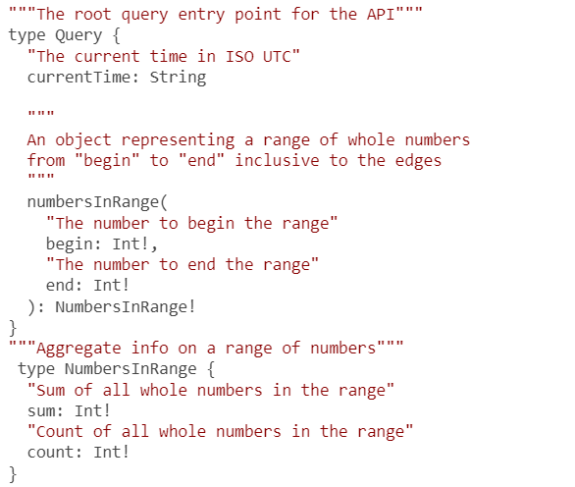
Generating SDL text from object-based schemas
Notes:
Note that the description of NumbersInRange is included right before it, surrounded by a set of three double quotes. Here’s an example of a well-described version of the API we have so far.
The schema language versus the object-based method
The schema language enables front-end developers to participate in designing the API and, more important, start using a mocked version of it right away. The frontend people on your team will absolutely love it. It enables them to participate in designing the API and, more important, start using a mocked version of it right away. The schema language text can serve as an early version of the API documentation.
However, completely relying on the full-schema text to create a GraphQL schema has a few drawbacks. You’ll need to put in some effort to make the code modularized and clear, and you’ll have to rely on coding patterns and tools to keep the schema-language text consistent with the tree of resolvers (aka resolvers map). These are solvable problems.
The biggest issue I see with the full-schema method is that you lose some flexibility in your code. All your types have to be written in that specific way that relies on the schema-language text. You can’t use constructors to create some types when you need to. You’re locked into this string-based approach. Although the schema-language text makes your types more readable, in many cases, you’ll need flexibility over readability.
The object-based method is flexible and easier to extend and manage. It does not suffer from any of the problems I just mentioned. Your code will be modular with it because your schema will be a bunch of objects. You also don’t need to merge modules, because these objects are designed and expected to work like a tree.
The only issue I see with the object-based method is that you have to deal with a lot more code around what’s important to manage in your modules (types and resolvers). Many developers see that as noise, and I do not blame them.
If you’re creating a small, well-defined GraphQL service, using the full-schema-string method is probably okay. However, in bigger and more agile projects, I think the more flexible and powerful object-based method is the way to go.
TIP
You should still use the schema-language text even if you’re using the object-based method.

Slide 49
Running the development environment
Setting up the GraphQL runtime
Communicating over HTTP
Building a schema using constructor objects
Generating SDL text from object-based schemas
Working with asynchronous functions
Table of Contents

Slide 50
Working with asynchronous functions
currentTime: {
type: GraphQLString,
resolve: () => {
const sleepToDate = new Date(new Date().getTime() + 5000);
while (sleepToDate > new Date()) {
// sleep
}
const isoString = new Date().toISOString();
return isoString.slice(11, 19);
},
},
Notes:
Both fields we have so far in this example are mapped to a normal synchronous resolver. However, if a field needs to do a lot of work to resolve its data, it should use an asynchronous resolver because, otherwise, the entire API service will be blocked and unable to serve other requests.
To demonstrate this problem, let’s fake a delay in processing the currentTime field. JavaScript has no sleep function, but it’s easy to accomplish something similar by comparing dates. Here’s one way to make the currentTime resolver function synchronously take 5 seconds to complete.

Slide 51
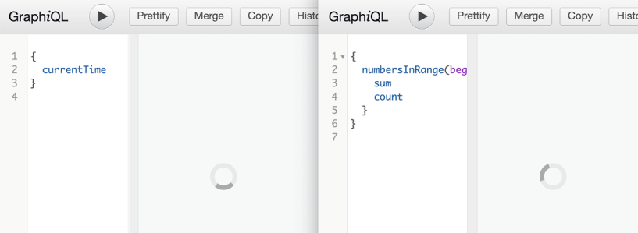
Working with asynchronous functions
Notes:
Now, each time you ask for the currentTime field, the server will spend 5 seconds doing nothing, and then it will return the answer. The problem is that during these 5 seconds, the whole node process for the server is completely blocked. A second requester cannot get any data from the API until the while loop in the first request is finished
You should never do that. Instead, all long-running processes should be done asynchronously either with native APIs offered by Node and its many packages or by forking the work over to a worker thread/process.

Slide 52
Working with asynchronous functions
currentTime: {
type: GraphQLString,
resolve: () => {
return new Promise(resolve => {
setTimeout(() => {
const isoString = new Date().toISOString();
resolve(isoString.slice(11, 19));
}, 5000);
});
},
};
Notes:
For example, to make the currentTime field fake-delay its response by 5 seconds but do so asynchronously, we can use the setTimeout method and wrap it in a promise object.

Slide 53
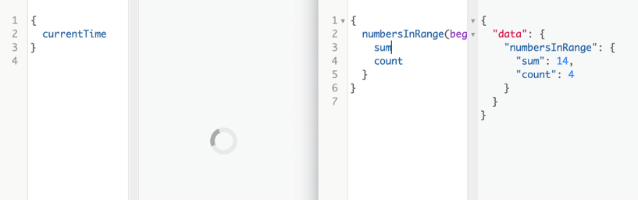
Working with asynchronous functions
Notes:
NOTE
We don’t need to await this promise. A resolver function can return a promise, and the executor will await that promise and use its data. This behavior is built into the GraphQL.js implementation.
With this change, each time you ask the API service for the currentTime field, it will still answer after 5 seconds, but the service process will not be blocked! Other requesters can ask for other parts of the API and get immediate responses while a requester is waiting for the currentTime
This is going to be very handy when we work with objects coming from databases, because we should definitely use asynchronous APIs to make all communications with all the databases.
I think we’re ready to do that!

Slide 54
Summary
A GraphQL service is centered around the concept of a schema that is made executable with resolver functions.
A GraphQL implementation like GraphQL.js takes care of the generic tasks involved in working with an executable schema.
You can interact with a GraphQL service using any communication interface.
Notes:
HTTP(S) is the popular choice for GraphQL services designed for web and mobile applications.
You can convert from one schema representation to another using GraphQL.js helper functions like buildSchema and printSchema.
You should not do long-running processes synchronously because doing so will block a GraphQL service process for all clients. Resolver functions in the GraphQL.js implementation can work with asynchronous promise-based operations out of the box.

Slide 55
"Complete Lab"

